Slide 1
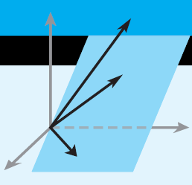
Elementary Linear Algebra
Howard Anton
Copyright © 2010 by John Wiley & Sons, Inc.
All rights reserved.
Chapter 4

Slide 2
Chapter 4
General Vector Spaces
4.1 Real Vector Spaces
4.2 Subspaces
4.3 Linear Independence
4.4 Coordinates and Basis
4.5 Dimension
4.6 Change of Basis
4.7 Row Space, Column Space, and Null Space
4.8 Rank, Nullity, and the Fundamental Matrix Spaces
4.9 Matrix Transformations from R^{n} to R^{m}
4.10 Properties of Matrix Transformations
4.11 Geometry of Matrix Operators on R²
4.12 Dynamical Systems and Markov Chains

Slide 3
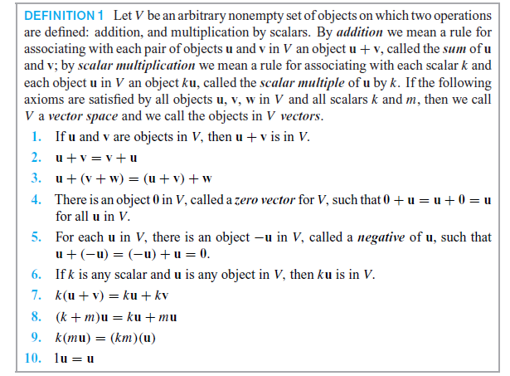
Section 4.1 Vector Space Axioms

Slide 4
To Show that a Set with Two Operations is a Vector Space
1. Identify the set V of objects that will become vectors.
2. Identify the addition and scalar multiplication operations on V.
3. Verify Axioms 1(closure under addition) and 6 (closure under scalar multiplication) ; that is, adding two vectors in V produces a vector in V, and multiplying a vector in V by a scalar also produces a vector in V.
4. Confirm that Axioms 2,3,4,5,7,8,9 and 10 hold.

Slide 5

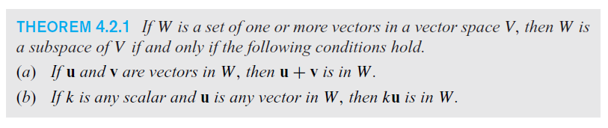
Section 4.2 Subspaces

Slide 6
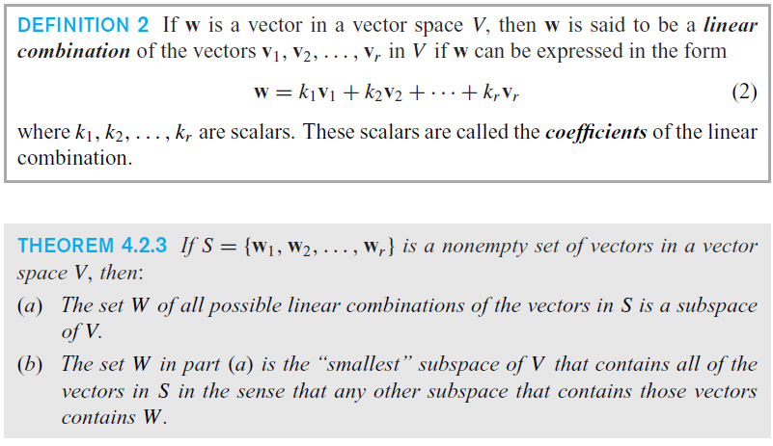
The ‘smallest’ subspace of a vector space V

Slide 7
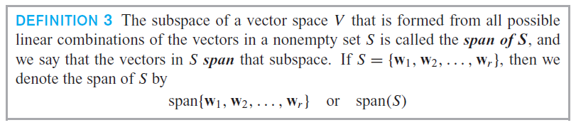
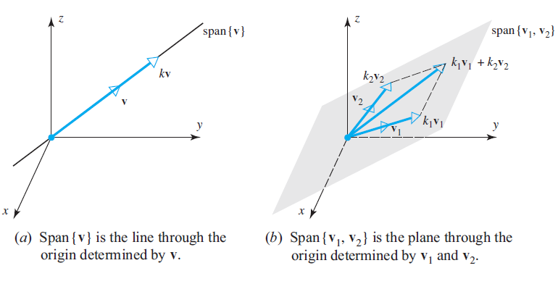
The span of S

Slide 8
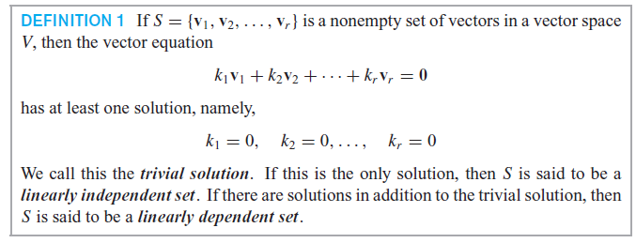
Section 4.3 Linear Independence

Slide 9
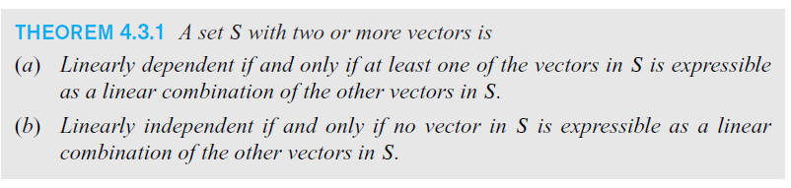
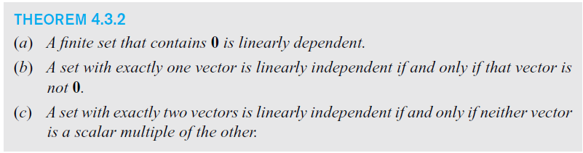
Linearly independence

Slide 10
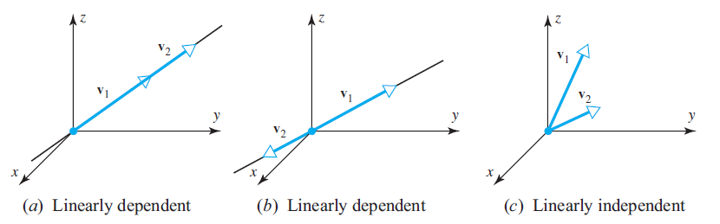
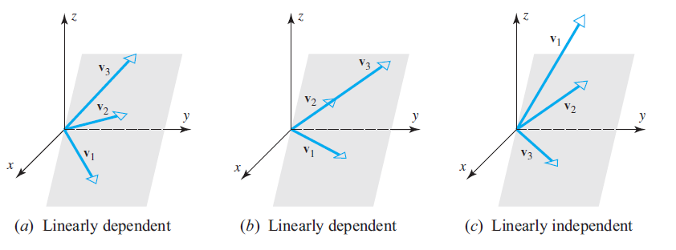
Linear Independence in R² and R³

Slide 11
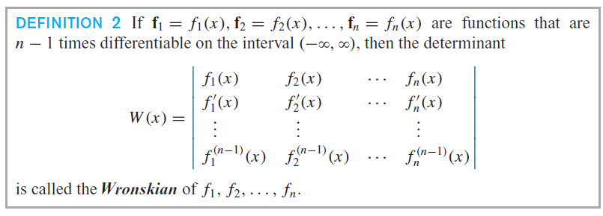
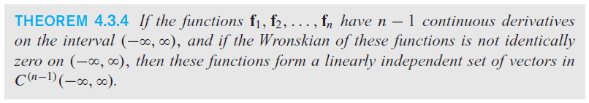
The Wronskian

Slide 12
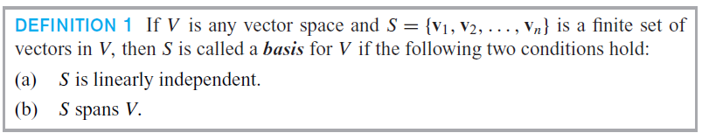
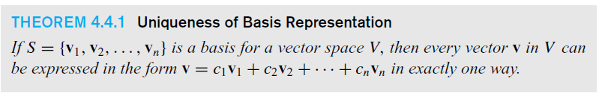
Section 4.4 Coordinates and Basis

Slide 13
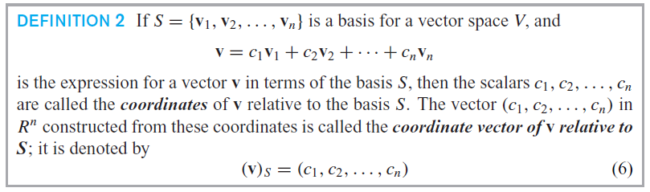
The coordinate vector

Slide 14
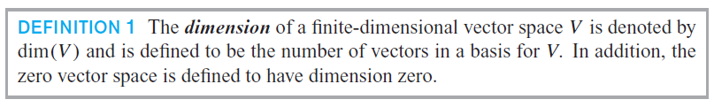
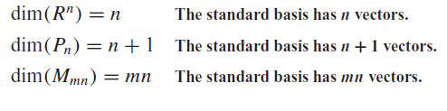
Section 4.5 Dimension

Slide 15
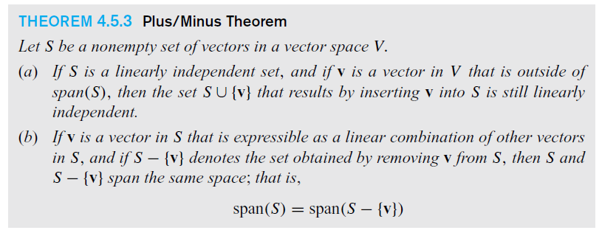
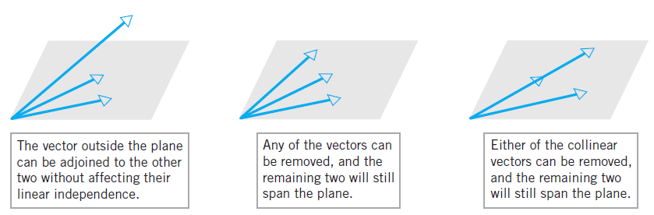
Plus / Minus Theorem

Slide 16
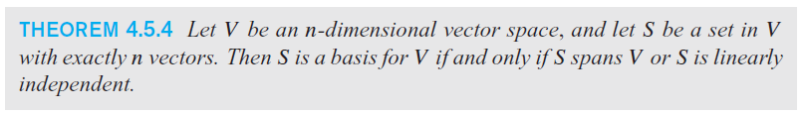
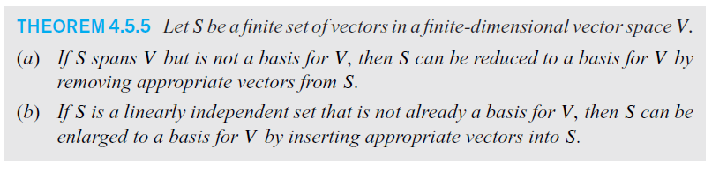
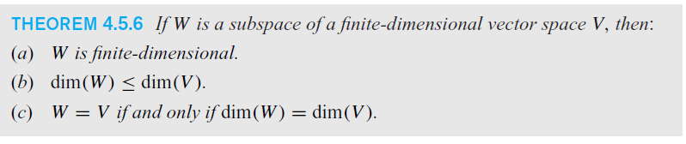

Slide 17
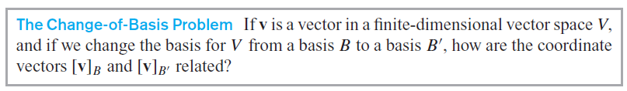
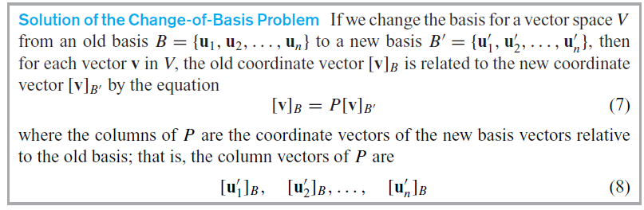
Section 4.6 Change of Basis

Slide 18

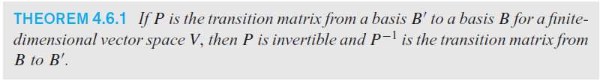
Transition Matrices

Slide 19
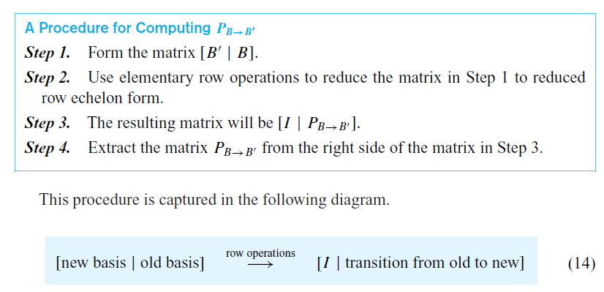
Computing the transition matrix

Slide 20
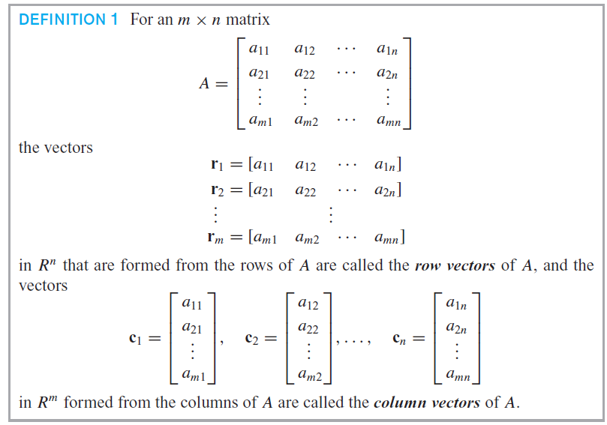
Section 4.7 Row Space,
Column Space, and Null Space

Slide 21
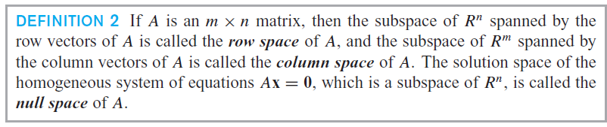
Row, column and null spaces

Slide 22
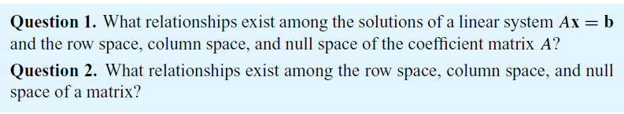

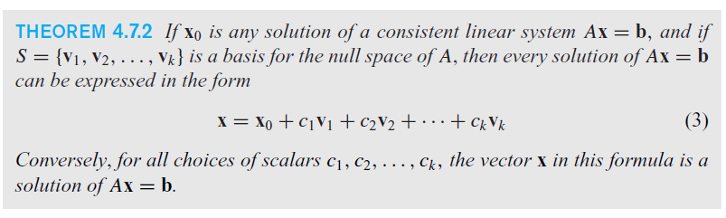
Systems of linear equations

Slide 23
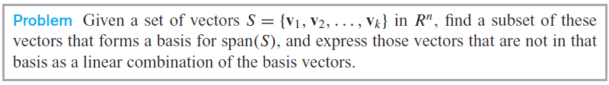
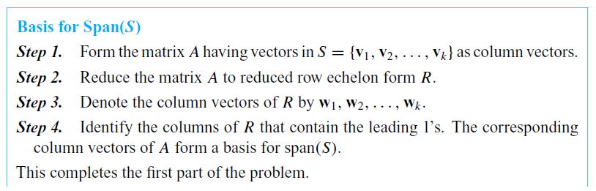
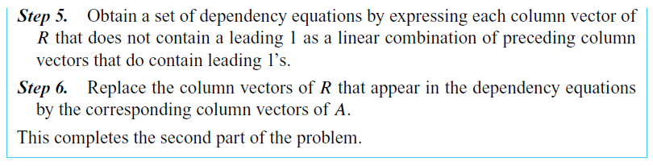
A basis for span (S)

Slide 24
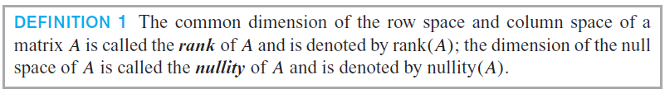
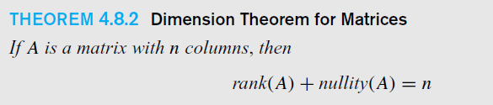
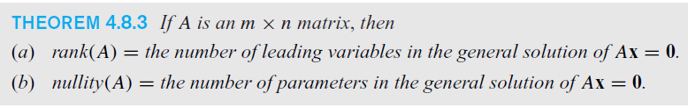
Section 4.8 Rank, Nullity, and the Fundamental Matrix Spaces

Slide 25
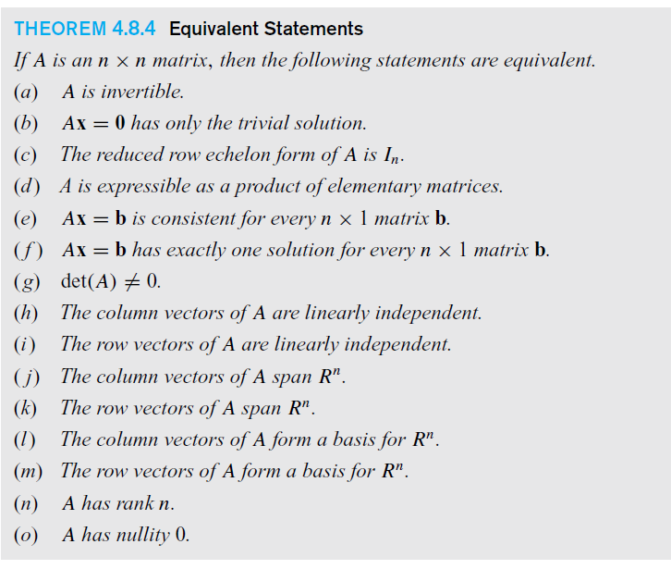

Slide 26
Fundamental Spaces of Matrix A
Row space of A
Null space of A
Column space of A
Null space of A^{T}

Slide 27
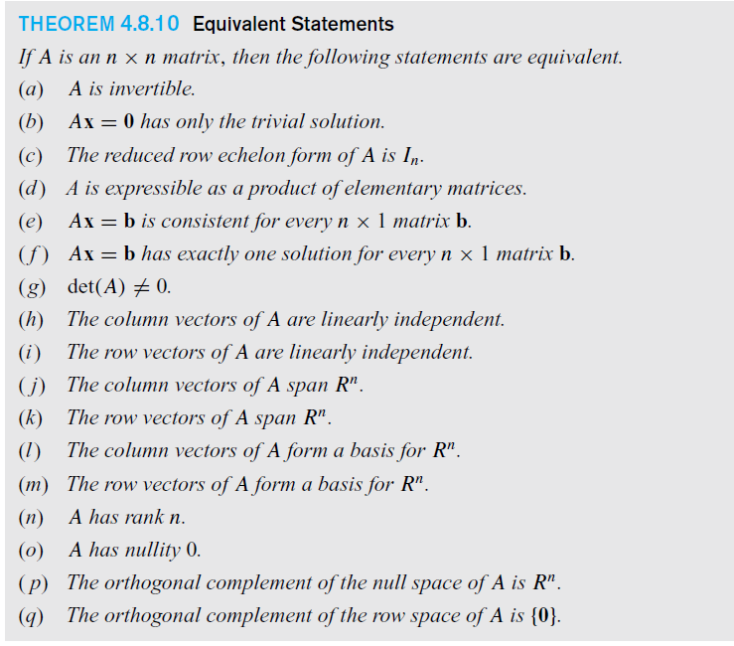

Slide 28
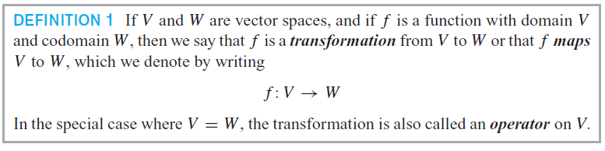
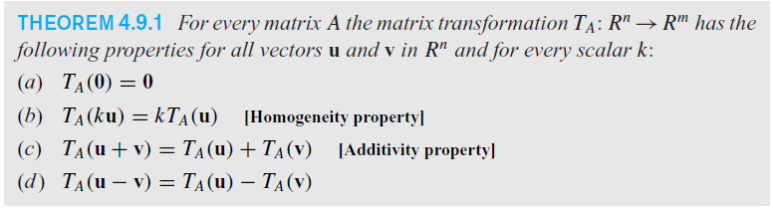
Section 4.9 Matrix Transformations from R^{n} to R^{m}

Slide 29
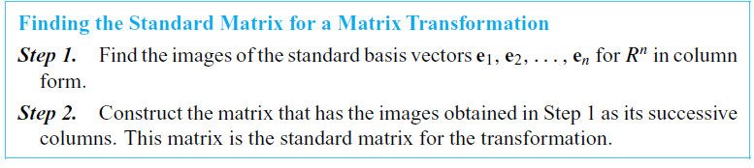
Finding the standard matrix for a matrix transformation

Slide 30
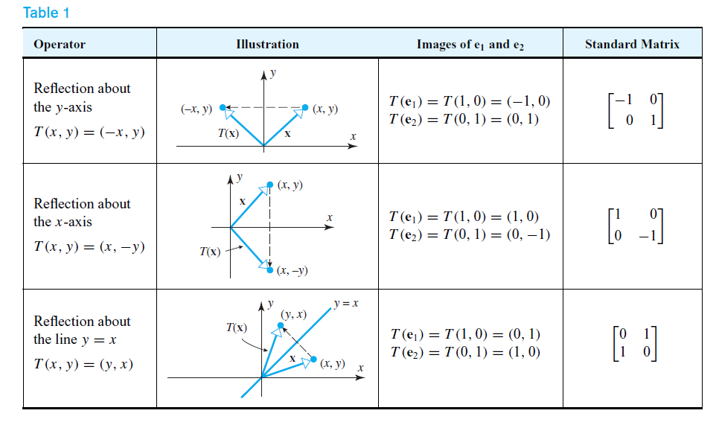

Slide 31
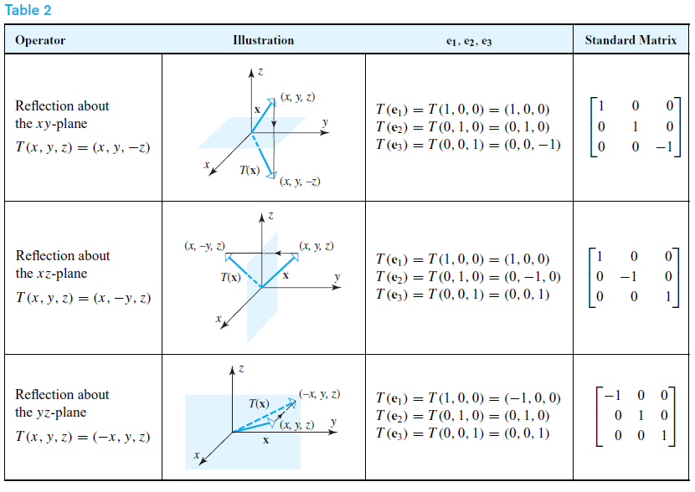

Slide 32
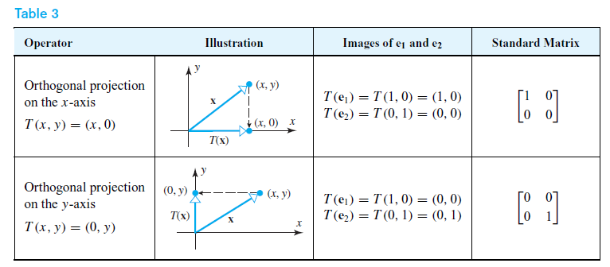

Slide 33
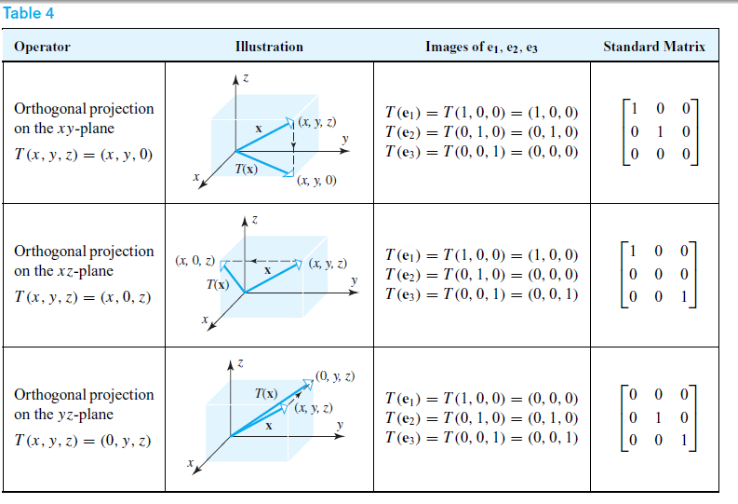

Slide 34
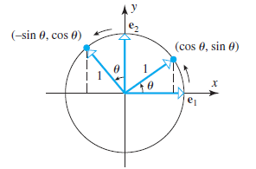
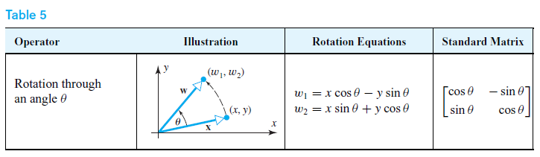
Rotation Operators

Slide 35
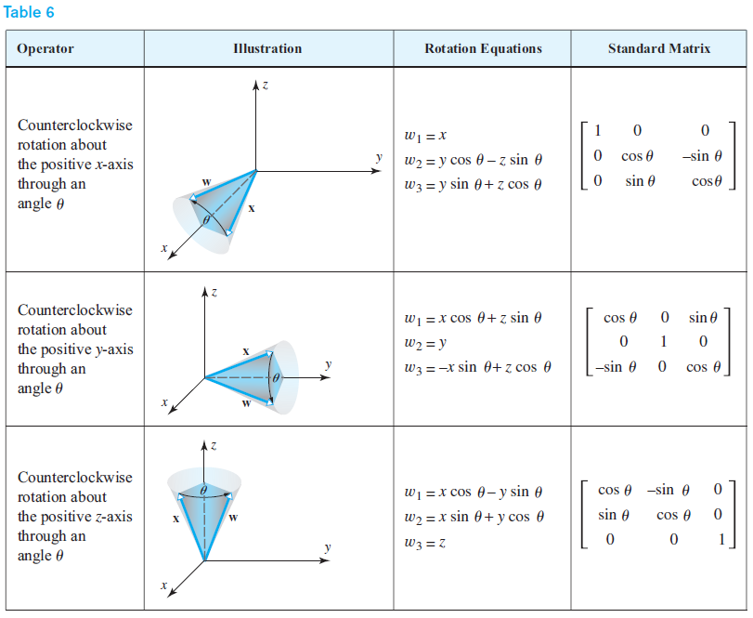

Slide 36
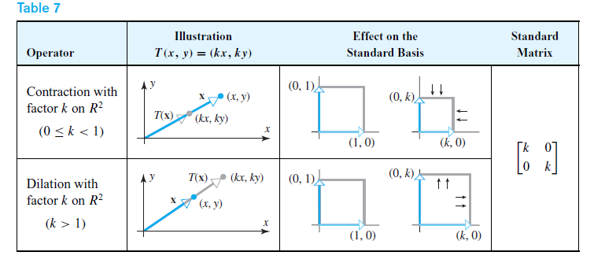
Dilations and Contractions

Slide 37


Slide 38

Expansion or Compression

Slide 39

Shear

Slide 40


Section 4.10 Properties of Matrix Transformations

Slide 41



Slide 42



Slide 43

Section 4.11 Geometry of Matrix Operators on R²

Slide 44


Matrix Operators

Slide 45

Computer Graphics

Slide 46


Section 4.12 Dynamical Systems and Markov Chains

Slide 47


Regular Markov Chains

